Slide 1
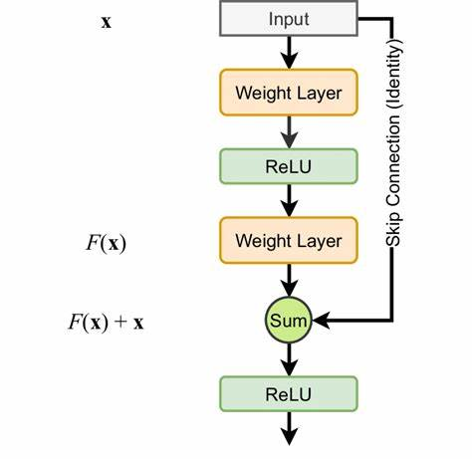
Applying Transfer Learning Techniques Using the ResNet Architecture for Garbage Classification
Presented By:-
Gurjot Singh
220190104
gurjot08@yorku.ca

Slide 2
Outline
Project Aim
Need for garbage classification
Issues in Deep Networks
What is Degradation of Training accuracy?
What is ResNet?
Performance of ResNet in Transfer Learning
What is Transfer Learning?
Data Selection and Preprocessing
Results
Predictions
Discussion and Future Works
Conclusion

Slide 3
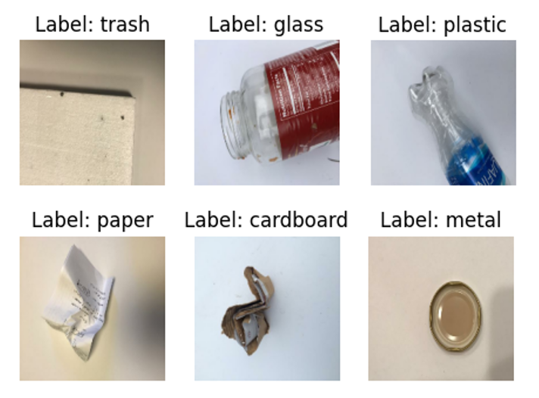
Project Aim
To develop an effective garbage classification model by leveraging transfer learning with the ResNet architecture.
I aim to create a system that can accurately categorize waste items into 6 different classes.
Figure: Example images from each class

Slide 4
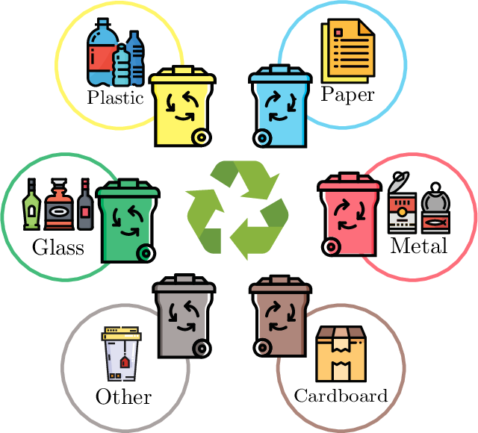
Need For Garbage Classification
As the population is growing day by day, so does the garbage, hence the problem of dealing with waste classification.
The garbage classification, which is a fundamental aspect of waste management, is crucial for the recycling process, thus reducing the environmental effect of the garbage.
Originally, this task has been a labor-intensive and error prone, requiring full human manual work.
But the invention of deep learning has helped to overcome the problem by making the task efficient and automated, thus waiving the human input.

Slide 5
Issues In Deep Networks
More computation complexity, leading to higher training time (in general).
Vanishing and Exploding Gradient problems.
Degradation of Training Accuracy.
Use of specialized hardware such as GPU for training.
The gradients that are used to update the network become extremely small or ”vanish” as they are backpropogated from the output layers to the earlier layers
The gradient continues to get larger which causes a large weight update and results in the Gradient Descent to diverge
Normalized Initialization of Weights.
Intermediate Normalization layers - Batch Normalization.
Residual connections.

Slide 6
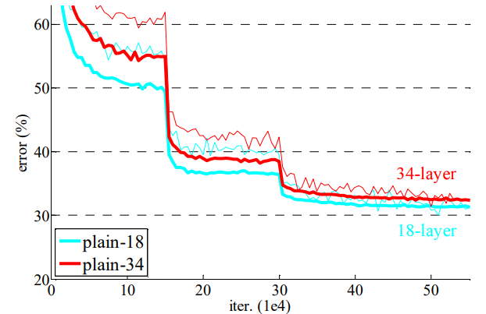
What is Degradation of Training Accuracy?
With the network depth increasing, accuracy gets saturated and then degrades rapidly.
Such degradation is not caused by overfitting, and adding more layers to a suitably deep model leads to higher training error.
The degradation (of training accuracy) indicates that not all systems are similarly easy to optimize.
Since a shallower model is basically a subset of a deeper model, in an ideal scenario, a deeper model should produce no higher training error than its shallower counterpart.
Only, if the added layers were able to learn an identity function, the deeper model would perform the same as its shallower counterpart.
With depth, model complexity increases, and it becomes difficult for current solvers to get the model to converge.
More non-linearity doesn’t necessarily mean better ability to approximate an identity mapping, given the current solvers.
Figure: Training deep models w/o residual connections on ImageNet

Slide 7
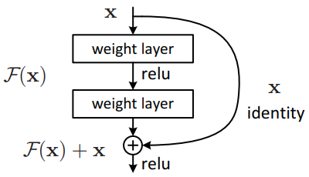
What is Residual Connection?
Instead of hoping each few stacked layers directly fit a desired underlying mapping, we explicitly let these layers fit a residual mapping.
Let the desired underlying mapping be H(x), where x is the input to the layers. Thus, H(x) is the mapping that the layers need to learn.
In a residual connection, we let the layers fit another mapping F(x) such that:-
F(x) = H(x) – x
The identity skip connection provides us the original x, so that the output after addition (before ReLU) is:-
F(x) + x = H(x), which is the actual desired mapping.
Figure: Residual Learning – a building block
Note: Such identity shortcut connections do not add parameters nor increases model complexity

Slide 8
Types of Skip-Connections
Let us assume x and y are the input and output vectors of the layers. W_{i} is the weight matrix of the layers, then the residual mapping to be learned is F. Then:-
When F(x) and x have the same shape (Identity Shortcut):
y = F(x, W_{i}) + x
When F(x) and x have different shape (Projection Shortcut):
y = F(x, W_{i}) + W_{s}x (W_{s} is a linear projection)
Figure: Residual Learning – a building block

Slide 9
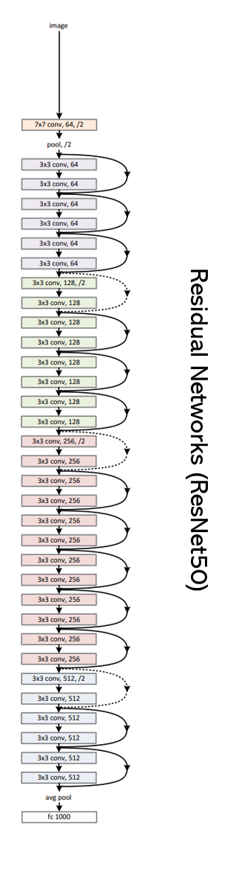
Network Architecture
Residual Network:
Dark/Continuous line represents the identity shortcuts
Dotted line represents Projection shortcuts.

Slide 10
Benefits of Residual Connections
Extremely deep residual nets are easy to optimize, but the counterpart “plain” nets (that simply stack layers) exhibit higher training error when the depth increases.
Deep residual nets can easily enjoy accuracy gains from greatly increased depth, producing results substantially better than previous networks – Solves the Degradation Problem.
Allows faster convergence in shallower models.

Slide 11
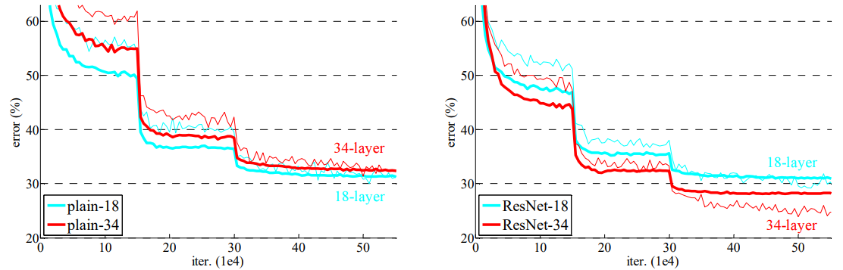
Performance of Residual Nets
Figure: Training on ImageNet. Thin curves denote training error, and bold curves denote validation error of the center crops.
Left: plain networks of 18 and 34 layers.
Right: ResNets of 18 and 34 layers.
In this plot, the residual networks have no extra parameter compared to their plain counterparts.
The 34-layer Plain net has higher training error throughout the whole training procedure, even though the solution space of the 18-layer plain network is a subspace of that of the 34-layer one – Degradation Problem
The 34-layer ResNet exhibits considerably lower training error and is generalizable to the validation data.
The 18-layer plain/residual nets are comparably accurate, but the 18-layer ResNet converges faster. “When the net is “not overly deep” (18 layers here), the current SGD solver is still able to find good solutions to the plain net. In this case, the ResNet eases the optimization by providing faster convergence at the early stage.”

Slide 12
Transfer Learning
The idea behind the transfer learning is to use a pretrained model which was trained on a large dataset like imagenet and use the knowledge gained from there and apply it to a different issue.
Using a pre-trained model for feature extraction: This is done by instantiating the pre-trained model and adding a fully-connected classifier on top. The pre-trained model is ”frozen” and only the weights of the classifier get updated during training of the added layers.
Fine-tuning a pre-trained model: To further improve performance, one might want to repurpose the top-level layers of the pre-trained models to the new dataset via fine-tuning. In this case, the model is run completely by unfreezing the top layers.

Slide 13
Data Selection and Preprocessing
The TrashNet dataset available on Kaggle as “Garbage Classification” dataset was used for this Project.
The data consisted of 6 classes : paper, glass, cardboard, metal, plastic and trash.
Preprocessing :-
Images were resized from 512 X 384 to 180 X 180.
Data was divided into train and valid split of 80:20.
Data Augmentation was performed on the training data.( Rotate, flip, contrast and brightness)
Figure: Sample Images from the dataset

Slide 14
Methodology
Transfer Learning using ResNet architecture was performed.
ResNet50, ResNet101, and ResNet152 were used for training.
4 fully connected convolutional layers( including the output layers) were added, based on the experiments.
Activation function used was ReLu in the layers and Softmax in the output layer.
First the added layers were trained on 10 epochs on a learning rate of 0.001 using the ImageNet weights, while top layers remain frozen.
Fine tuning was performed by training the full model after unfreezing the top layers.
In Fine tuning, the learning rate was 1 X e^-5 and 100 epochs were done.
This process was done for all the three different models and results were noted.

Slide 15
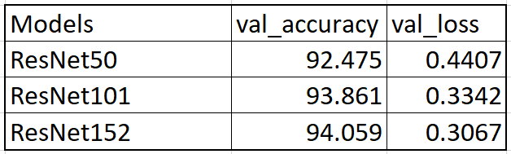
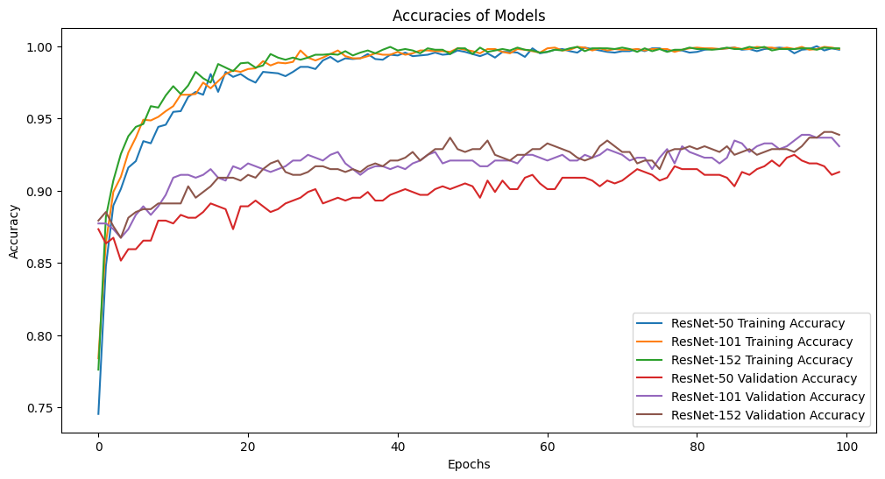
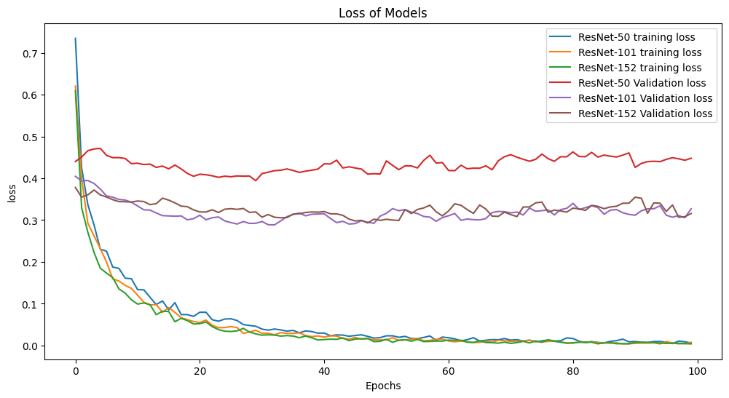
Results
ResNet152 performed the best
Basic Notion about the increasing depth of the networks got true.

Slide 16
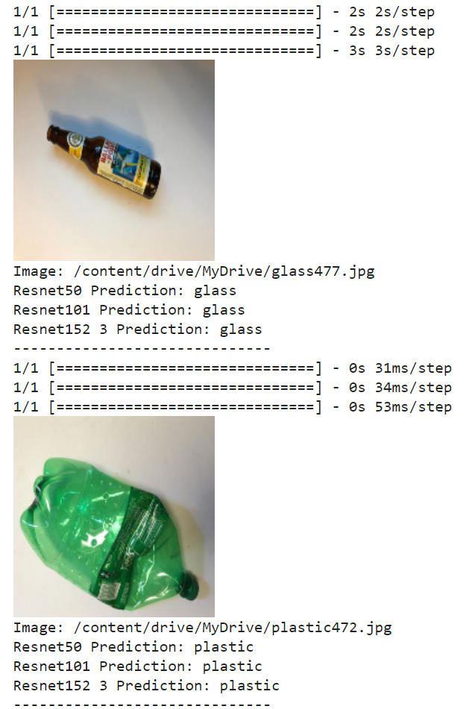
Prediction
All Models are Predicting correctly.

Slide 17
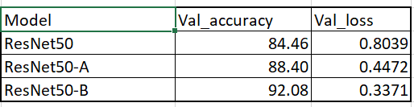
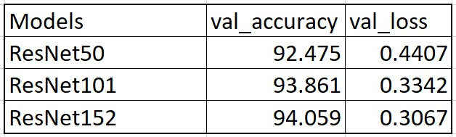
Discussion
A Small comparison can be made between this project and An Improved ResNet-50 for Garbage Image Classification (Ma et al., 2022)”
The paper proposes an improved ResNet-50 model for garbage image classification to address issues with existing models like lack of data, few samples, and inter-class similarity.
Modifications are made in two areas:
(a) Residual block is altered by adding an attention module (CBAM) to filter features and changing the downsampling method to reduce information loss. (b) Multi-scale feature fusion is added through horizontal and vertical fusion to optimize feature usage.
Training in this model was done on 250 epochs.
Figure: Performance of Author’s model
Figure: Performance of my model

Slide 18
Conclusion
To conclude, In context to Garbage Classsification through transfer Learining using the ResNet architecture, this project has yielded successful and promising results as evident from the achieved accuracies.
Further, we may also say that, in future the proposed methods in ”An Improved ResNet-50 for Garbage Image Classification (Ma et al., 2022)” can also be applied onto this project, and test the performance of the model, as there may be chances to achieve a better model than this.

Slide 19
Thanks!

